Slide 1

EY Techathon 6.0 (BFSI)

Slide 2







Team Details
Team Name: roshankumargupta.sh
Problem Statement : EY Techathon 6.0 (BFSI)
Team Member 1 Roshan Kumar Gupta
Chandigarh University
9334098565
Frontend Developer
Team Member 2 Srishti Mahay
Chandigarh University
9463883055
Research and Development
Team Member 3
Manya Babbar
Chandigarh University
6283041247
UI-UX Developer
Team Member 4
Harshit Sharma
Chandigarh University
8837881882
Backend Developer
Team Member 5
Parv Arhatia
Chandigarh University
6392714540
Backend Developer

Slide 3
Executive Summary
This project is about developing an AI-based loan eligibility chatbot that helps automate the loan checking process used by banks. In the current system, loan approval involves a lot of manual work such as checking KYC documents, salary details, and credit scores. This makes the process slow and sometimes confusing for customers. Our project aims to simplify this process by using an intelligent chatbot that can do an initial eligibility check automatically.
The system is designed using a multi-agent approach. It includes one Master Agent and four sub-agents: Sales Agent, KYC Agent, Salary Agent, and Credit Agent. The Sales Agent interacts with the user and collects basic details about the loan. The KYC Agent checks the user’s identity details, the Salary Agent evaluates income and employment stability, and the Credit Agent analyzes the credit score. The Master Agent controls the overall flow and combines the results from all agents to decide whether the user is eligible for a loan.
This chatbot provides quick responses about loan eligibility, required documents, and next steps. The project helps reduce manual effort, saves time, and improves customer experience. It also reflects how AI can be used in real-world financial applications, which aligns well with EY’s focus on digital innovation.

Slide 4
Problem statement - Our understanding
The current loan approval process depends largely on manual verification of KYC documents, salary proofs, and credit scores by bank employees. This makes the process slow, repetitive, and prone to errors. Customers often face delays, multiple follow-ups, and lack of instant approval, while bank staff spend significant time on routine checks, reducing overall efficiency. To solve this Problem and to save time efficiently, we have built a Web-based Agentic AI Assistant for Retail Loan Processing.
Target Industry: Fintech
Industry Type: B2C
User Group: Prospects and Existing Customers
User Department: Retail Sales Division
Solution Scenario: A Master Agent orchestrates multiple specialized worker agents to autonomously manage end-to-end loan sales process, from human-like negotiation to final sanction generation
Proposed Data Flow: Customer chat inputs flow from the master agent for negotiation, which routes negotiation to the sales agent, followed by evaluation, and finally the sanction agent generates letter.
Output: Web-based Agentic AI Assistant Application for Retail Loan Processing

Slide 5
Explain, in brief, how you intend to solve the problem at hand. Preferably include the following (Methodology/approach):
Please elaborate on the solution value proposition to the target user group. How will your solution cover the problem areas?
Response: Our Agentic AI automates the entire loan sales lifecycle, replacing manual call centers. It solves the *scalability* bottleneck by handling thousands of concurrent applications 24/7 and ensures policy adherence by programmatically enforcing credit rules (e.g., 50% EMI cap) that human agents often miss.
What are the impact metrics that you propose to use to analyse the effect of the solution?
Response: 1.Conversion Rate: Percentage of chats resulting in a generated Sanction Letter. 2. Turnaround Time (TAT): Time reduced from "application" to "decision" (Target: < 2 mins). 3. Cost Efficiency: Reduction in human-agent operational costs. 4. Risk Accuracy: Percentage of correct rejections based on Credit Score < 700.
What are the technologies (languages, platforms, APIs, hardware, sponsored tools, technologies stacks, framework etc.) involved?
Response: 1.Frontend: React (Vite), TailwindCSS, Framer Motion. 2.Backend: Node.js, Express.js. 3.AI Engine: Local LLM (Llama-3 via Ollama) for privacy and zero-cost inference. 4.Data: JSON-based Mock Databases (CRM, Bureau, Products). 5.Orchestration: Custom MasterAgent routing logic (LangGraph-inspired).

Slide 6
Please state the assumptions, constraints and solution decision points (Reason behind choosing a technology) Response: 1. Assumption: User provides a valid mobile number mapped to our mockCRM.json dataset. 2. Constraint: No real real-time banking APIs available; simulated via mockBureau.json. 3. Decision:* Used Local LLM (Ollama) instead of OpenAI to ensure data privacy (PII security) and eliminate per-token costs during development. 4. Decision: Built on Node.js for non-blocking I/O to handle multiple concurrent agent streams. How easily can your solution be implemented and how effective will it be? Response: 1. Implementation: Highly portable; the entire backend is containerized, and the "Agent" logic is modular (separate files for salesAgent.js, underwritingAgent.js), allowing easy swap-outs for new models. 2. Effectiveness:* The Multi-Agent approach reduces hallucination by separating "Sales Persuasion" (Creative LLM) from "Credit Underwriting" (Strict Logic/Math), ensuring >95% accuracy in loan decisions. How robust / secure / easily scalable and extensible is the solution? Response: 1. Robustness: Includes regex-based guardrails to sanitize Model outputs and fallback mechanisms if the LLM fails. 2. Scalability: Stateless REST API architecture allows horizontal scaling behind a load balancer; session state can be migrated to Redis. 3. Extensibility: New products (e.g., Home Loans) can be added simply by updating products.toon and adding a new WorkerAgent module. What are the solution components that you would like to build and demonstrate; if you progress through next round. Response: 1. Orchestrator Engine: masterAgent.js routing intents. 2. Sales Bot: salesAgent.js using empathy and negotiation tactics. 3. Credit Engine: underwritingAgent.js implementing the "2x Limit" and "Score > 700" rules. 4. Sanction Generator: sanctionAgent.js creating the final approval artifact. 5. Live Web Interface: React-based chat UI with real-time feedback.

Slide 7

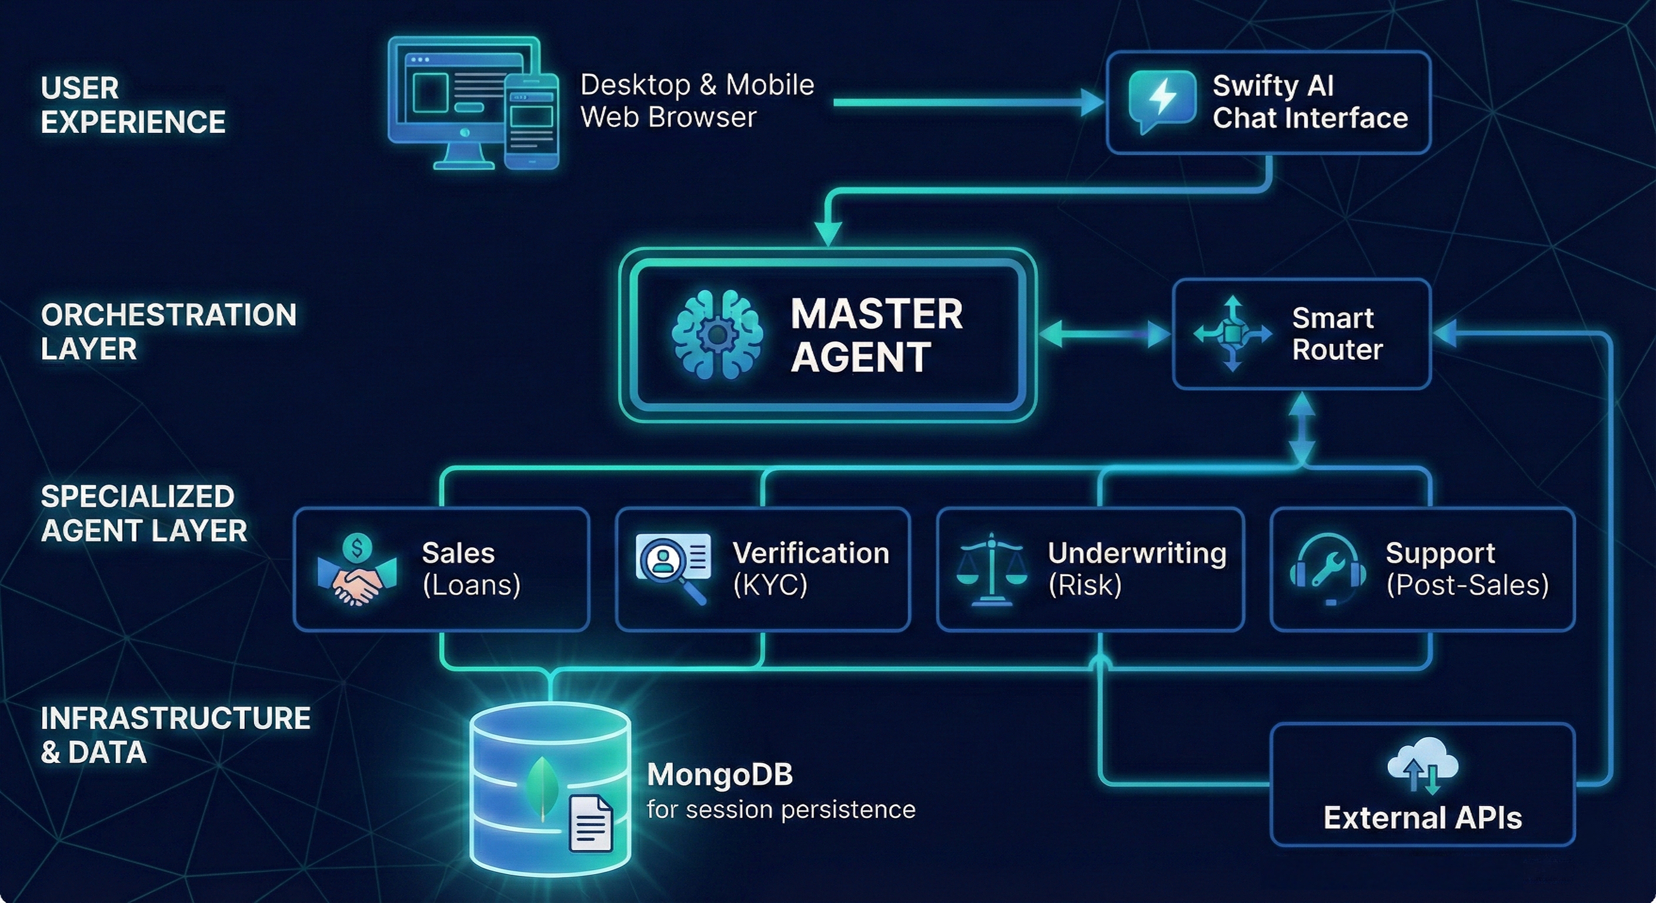
Architecture diagram:

Slide 8
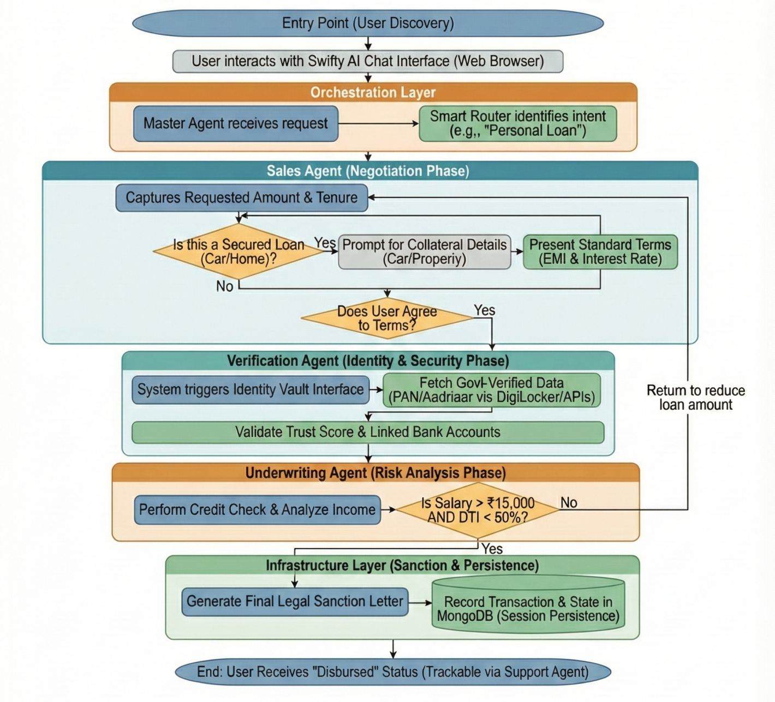
Flow chart :
Wireframes : https://github.com/rk-roshan-kr/SwiftyAi/blob/main/wireframe.pdf
Code Repository : https://github.com/rk-roshan-kr/SwiftyAi

Slide 9



DEMO VIDEO Click [ HERE ]

